Slide 1
Advocating for Best Practice
The New South Wales Experience

Slide 2
The Campaign Begins….2006
MOLLY is just eight years old. Some time before 2am on a humid January night, she ran more than half a kilometre from her home in Hosking Crescent, Glenfield, past open parklands and into a darkened street nearby.
When a family friend, Wayne Smith, opened the door she screamed that her mum had told her to run, to run for her life.
Inside the fibro townhouse Molly shared with her mother, Adele Lynch, baby brother Mason and Aaron Reed - her mother's new boyfriend - a noisy and violent fight had been escalating for more than three hours “Too Late for Molly, but there must be answers” Sydney Morning Herald Feb 27th 2006

Slide 3
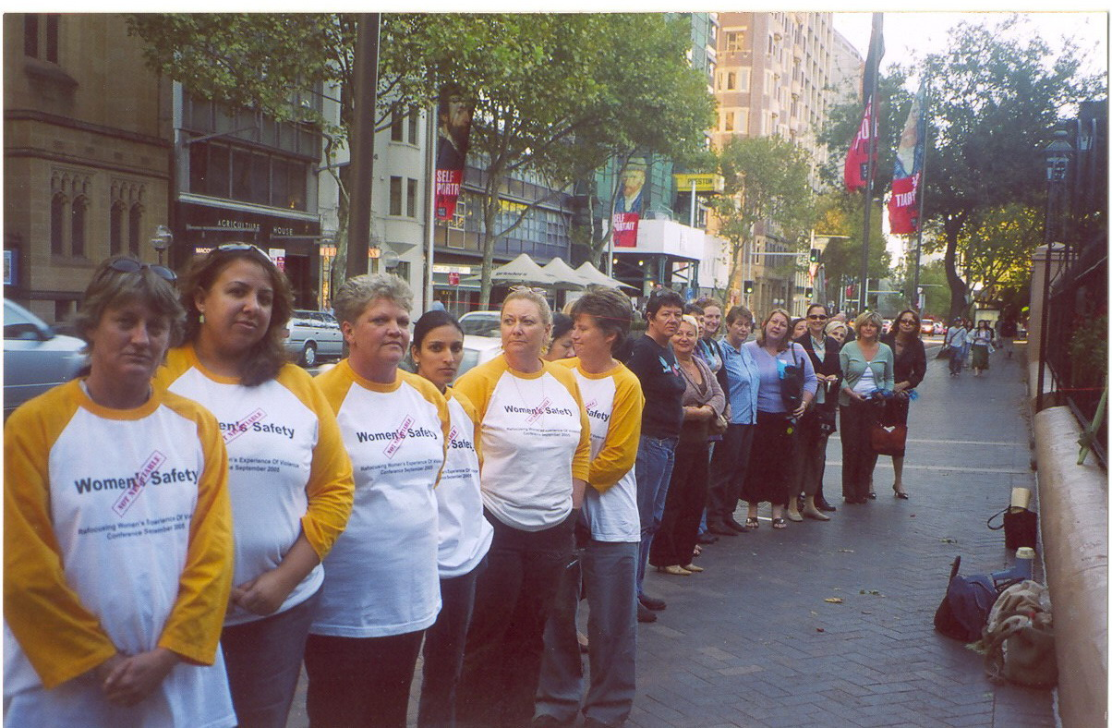

Slide 4
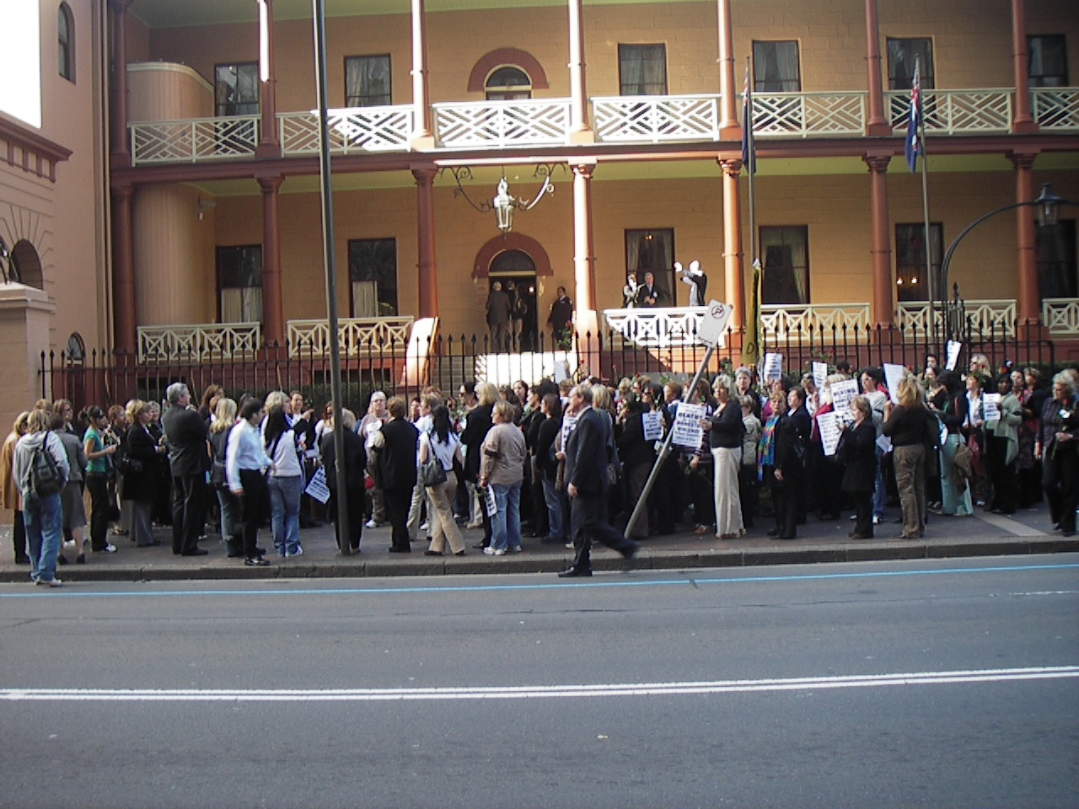

Slide 5
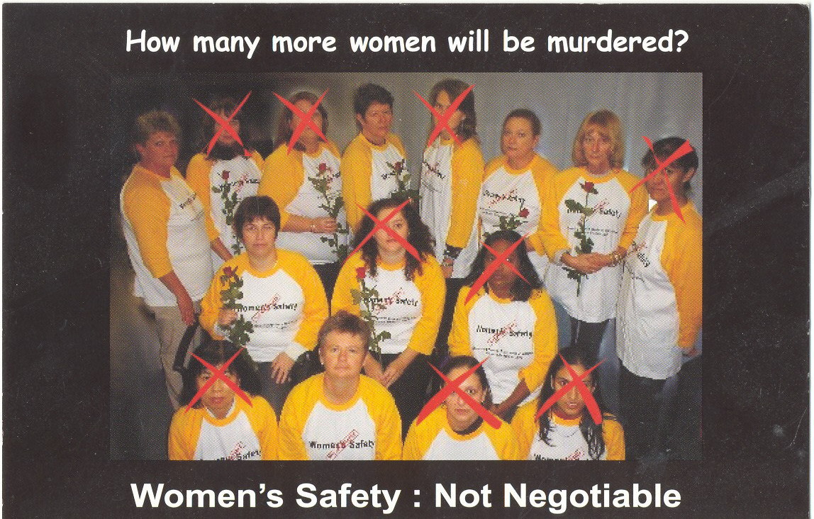
10,000 POSTCARDS

Slide 6
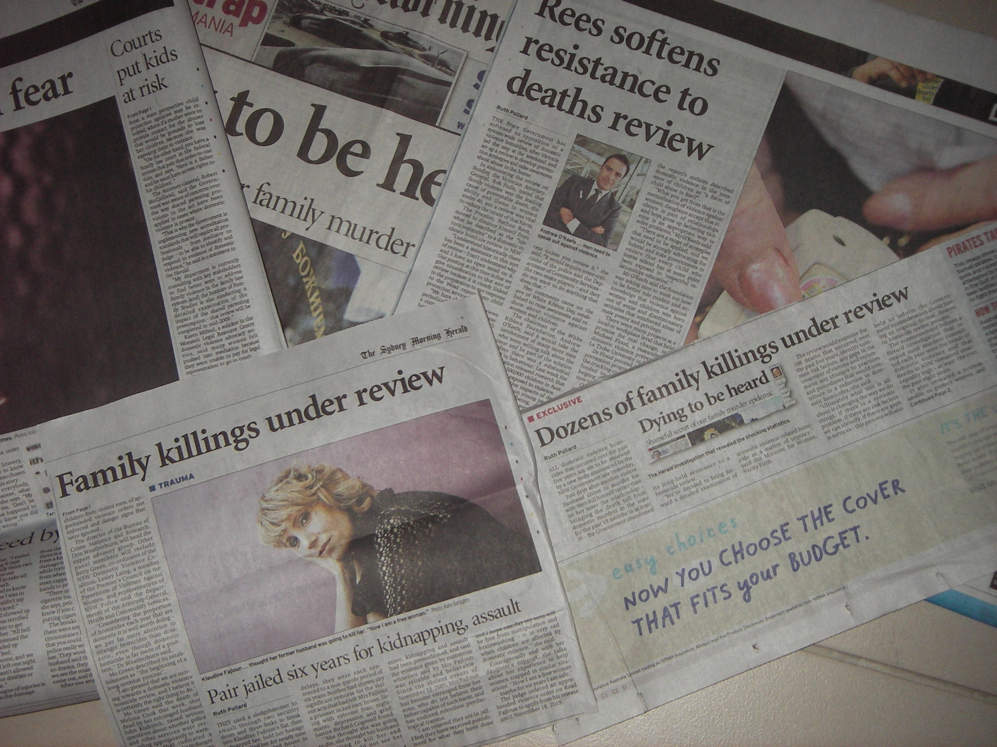

Slide 7
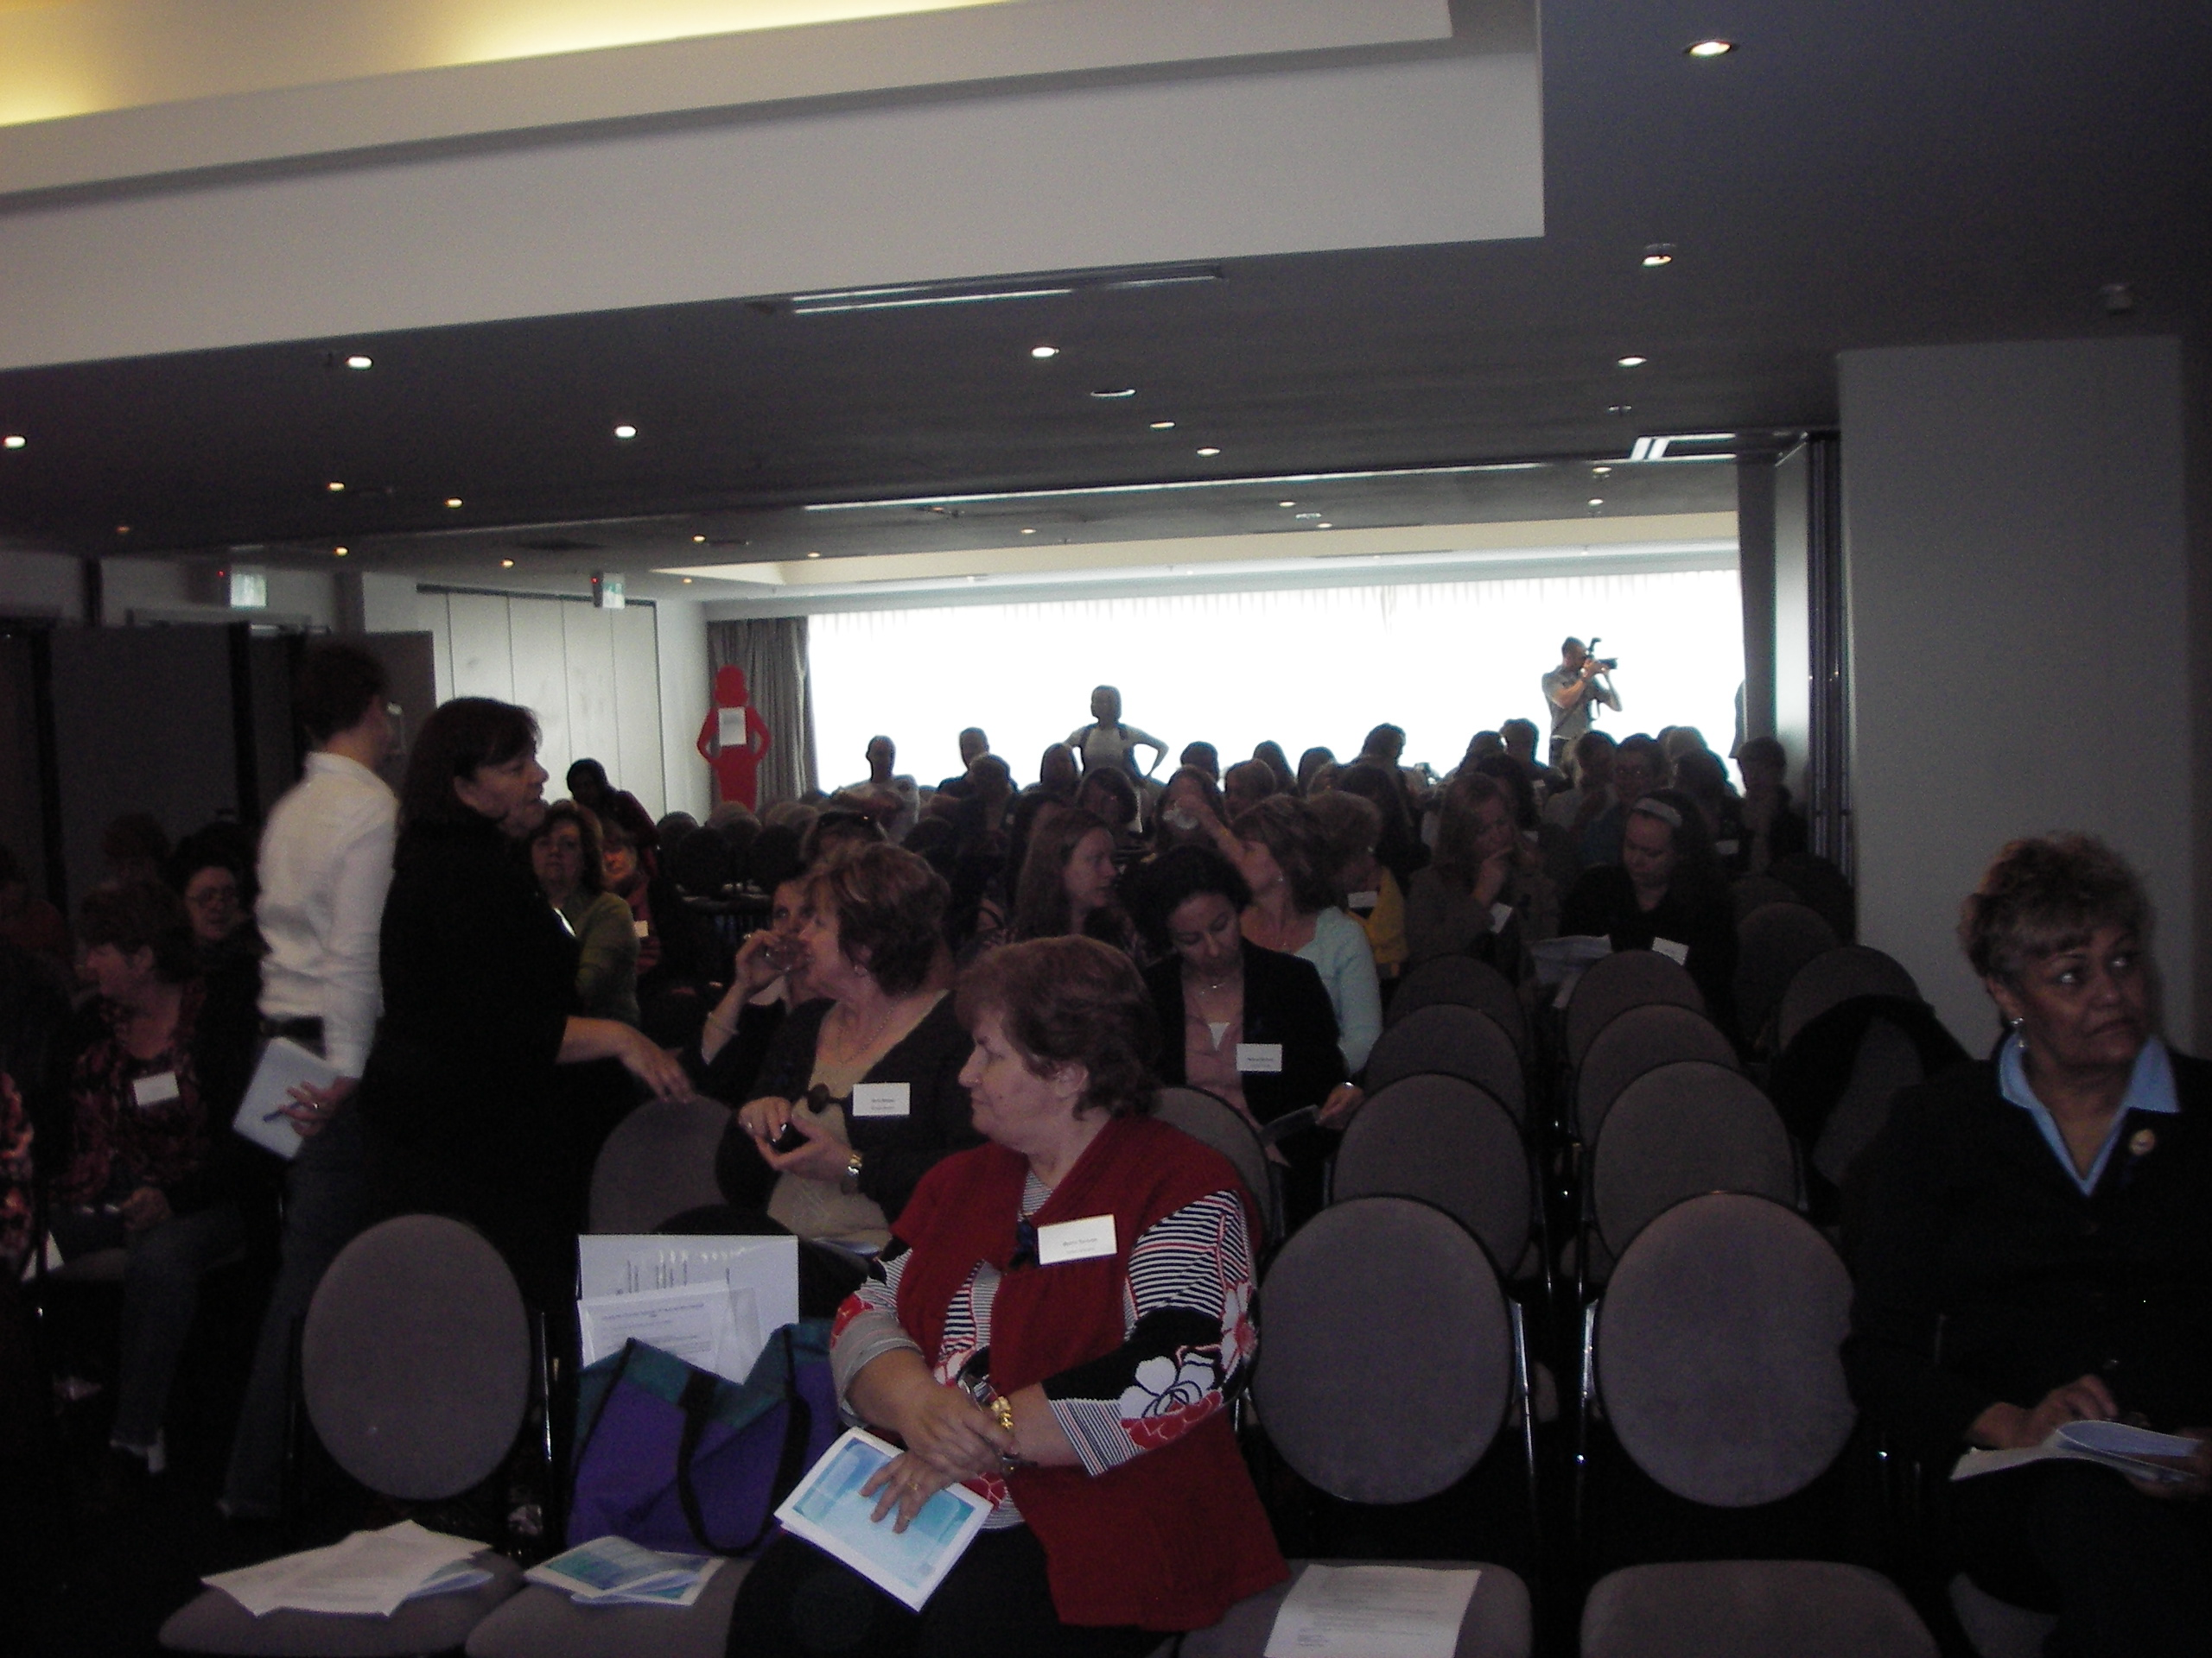

Slide 9
NSW DOMESTIC VIOLENCE DEATH REVIEW TEAM
Established from recommendations of Domestic Violence Homicide Advisory Panel (2009)
Identified functions
  Review individual deaths
  Identify trends and patterns
  Establish & maintain a comprehensive data base
  Conduct research
  Identify best practice guidelines for agencies
  Educate community and professionals
  Provide a publicly available report with findings and recommendations

Slide 10
Core functions
Reduce the incidence of domestic violence deaths and facilitate improvements to systems and services
Learning through understanding the contributing factors & identifying system gaps and responses

Slide 11
Membership
Underpinned by a legislative framework
Multi agency team 15 members in total, government representatives by Ministerial appointment
  Police
  Health
  Human Services
  Dept. Education & Training
  Dept. Housing
  Dept. Justice & Attorney General
  Dept. Premier & Cabinet
  Community Services
  Aboriginal Affairs
  Juvenile Justice
  Ageing Disability & Home Care
  2 non government service providers
  2 persons deemed to hold appropriate expertise

Slide 12
Review Process
Closed cases
In depth review
  Team provided with information of each case
  Additional agencies identified
  Requests for information made
Risk factors of each case noted
Systems reviewed
Drafting of recommendations

Slide 13
So Far......
First Annual Report (2010-2010)tabled in Legislative Council Nov 8th 2011, Legislative Assembly 11th Nov 2011
Team has met 6 times since March 2011
  Conducted 20 in-depth case reviews
2011-12 Annual Report will include case summaries and recommendations in relation to 16 identified domestic violence deaths in NSW between March 2008-June 2009

Slide 14
Data Base
Comprehensive & captures range of information from deaths occurring in NSW from 1 July 2000
  Deceased/ perpetrator demographic information
    Employment
    Criminal history
    Substance abuse
    Psychiatric history
  Deceased/perpetrator relationship details
  Domestic violence history – history of court orders
  Details surrounding the killing/s
    Manner of death
    Weapon
    Child witnesses
    Location

Slide 15
Data base con’t
Deceased/perpetrator service contact history in 6 months and 12 months prior to the killing
  Includes 30 different government and non government services providers
Risk factors identifiable between deceased/perpetrator or other related parties
  includes 25 specific risk factors
2011-2012 Annual Report will include data analysis for all homicides occurring between 1 July 200-30June 2009

Slide 16
Best Practice Principles for an effective Model
Team Membership
      Multi disciplinary
      Multi agency
      Diverse
      Inclusive
Statutory protections in place
      Confidentiality
      Compulsion to provide information, files, evidence, immunity from prosecution

Slide 17
Creates time line of events
  Conveys sense of movement
  Identifies barriers and challenges faced by victim/offender
Accountability
  Recommendations coupled with reporting mechanism including follow up
  Report is publicly available

Slide 18
Accurate data collection
Generates research
    Builds on learnings
    Contributes to a growing body of evidence
Interdisciplinary dialogue
    Development of best practice
Informs & stimulates education, community awareness initiatives

Slide 19
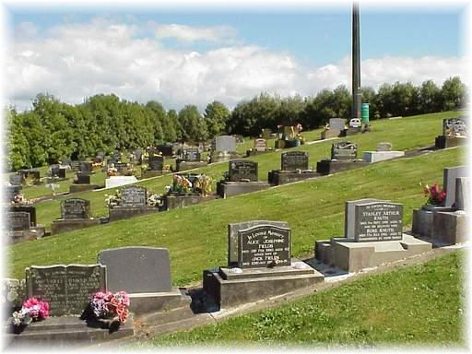
Their deaths are not unpredictable, isolated events without context or warning.
Most of the victims whose murders we discuss in this report reached out for help.
They planned with friends, family, and co-workers. They went to therapists,
attorneys, and health care providers. They called police. They went
to court. They worked with domestic violence advocates. They stayed in
shelter. They struggled to be mothers and friends and students and
employees and volunteers and to contribute to their communities in the
face of terrible violence from someone close to them…
“Now that We Know” Recommendations from Washington State Domestic Violence Fatality Review December 2008

